Slide 1

AI training group
Weekly Report
Nguyen khai phu – OCT 27 2023

Slide 2
Changes since last week
ISP008 foundation
deepSBD
Layer | Feature map
Data | 3 x 16 x 64 x 64
Conv3d_1 + MaxPool + BatchNorm | 32 x 12 x 15 x 15
Conv3d_2 + MaxPool + BatchNorm | 64 x 8 x 3 x 3
Conv3d_3 + BatchNorm | 256 x 8 x 3 x 3
Conv3d_4 + BatchNorm | 512 x 8 x 3 x 3
Conv3d_5 + BatchNorm | 256 x 8 x 3 x 3
Linear + sigmoid | 1
Data: 602 positives and 602 negatives
2
CISP-1352-A21 - ISP-DOC-STYLETYPE-Templates © Robert Bosch GmbH 2016. All rights reserved, also regarding any disposal, exploitation, reproduction, editing, distribution, as well as in the event of applications for industrial property rights.

Slide 3
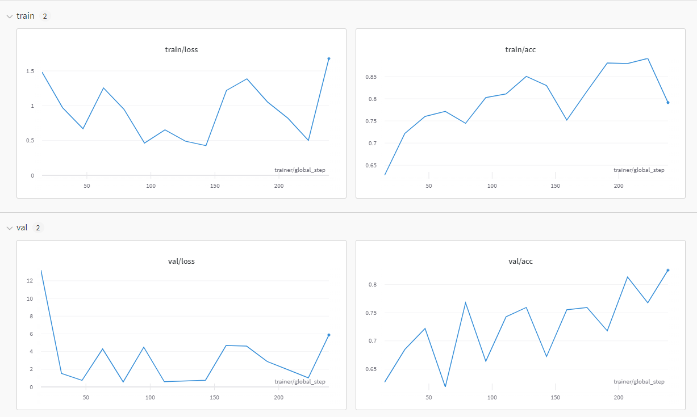
Training results
ISP008 foundation
Train – val split ratio: 8:2
Batch size: 64
Early stop & reduce LR
2
CISP-1352-A21 - ISP-DOC-STYLETYPE-Templates © Robert Bosch GmbH 2016. All rights reserved, also regarding any disposal, exploitation, reproduction, editing, distribution, as well as in the event of applications for industrial property rights.

